Slide 1

RATING PREDICTION PROJECT
Submitted by:
Kunal chand
Internship-19

Slide 2

Introduction
In this time of Internet era, more and more online shopping websites are coming in the frame, for more business growth they need review and ratings for there product. Our project is based on the introduction of this columns on previous reviews.

Slide 3
Business Problem Framing
In this time of in Internet era, more and more online shopping websites are coming in the frame, for more business growth they need review and ratings for there product as we see advertisement through the mouth is very impactful same in the online world more no of reviews means more no of customers buy the product. same with our client who has a website where people write different reviews for technical products. Now they are adding a new feature to their website i.e. The reviewer will have to add stars(rating) as well with the review. The rating is out 5 stars and it only has 5 options available 1 star, 2 stars, 3 stars, 4 stars, 5 stars. Now they want to predict ratings for the reviews which were written in the past and they don’t have a rating. So, we have to build an application that can predict the rating by seeing the review.

Slide 4
The 7 Key Steps To Build Your Machine Learning Model
Step 1: Collect Data.
Step 2: Prepare the data.
Step 3: Choose the model.
Step 4 Train your machine model.
Step 5: Evaluation.
Step 6: Parameter Tuning.
Step 7: Prediction or Inference.

Slide 5
Conceptual Background of the Domain Problem
The conceptual background of the problem depends on the language and words which make any review good or bad, our main motto is to find those words which are highly malignant which predicts the review for 5* rating or 1* rating.
Here 5*,4* &3* rating is good and 2*,&1* rating is bad all we have to find out by using scrapped data from different e-commerce websites.

Slide 6
Review of Literature
Data exploration is the first step in data analysis and typically involves summarizing the main characteristics of a data set, including its size, accuracy, initial patterns in the data, and other attributes. It is commonly conducted by data analysts using visual analytics tools, but it can also be done in more advanced statistical software, Python. Before it can analyse data collected by multiple data sources and stored in data warehouses or any scrapped data from websites, an organization must know how many cases are in a data set, what variables are included, how many missing values there are, and what general hypotheses the data is likely to support. An initial exploration of the data set can help answer these questions by familiarizing analysts with the data with which they are working. We divided the data 7:3 for Training and Testing purposes respectively.

Slide 7
Motivation for the Problem Undertaken
Every problem of Machine learning gives us chance to enhance and develop problem-solving skills. These Problems do’s the same.
When this real-life problem of predicting whether the reviews to any product increase or decrease its sales, whether to rely on old data or new data words are words they are accepted globally important and with help of A. I technology we make a completely new model of detection. As Data scientists it is our role to help and understand the market better with newer data, for constructing real-life helpful models for companies.
In this project, we have to scrape at least 20000 rows of data. You can scrape more data as well, it’s up to you. more the data better the model In this section you need to scrape the reviews of different laptops, Phones, Headphones, smartwatches, Professional Cameras, Printers, Monitors, Home theater, Routers from different e-commerce websites. We need these columns 1) reviews of the product. 2) rating of the product.
And we do the same we scrap 23000 rows of data for our model building phase.

Slide 8
Data Sources and their formats
Data Set Description
The data set contains the training set, which has approximately 23000 rows of data.
The data set includes:
Review: Review columns show all the different product reviews over the product.
Rating: These feature columns are rated out of 5, 5 is the highest, and 1 is the lowest.
This project is more about exploration, feature engineering, and classification that can be done on this data. Since the data set is huge and includes many categories of comments, we can do a good amount of data exploration and derive some interesting features using the comments text column available.

Slide 9
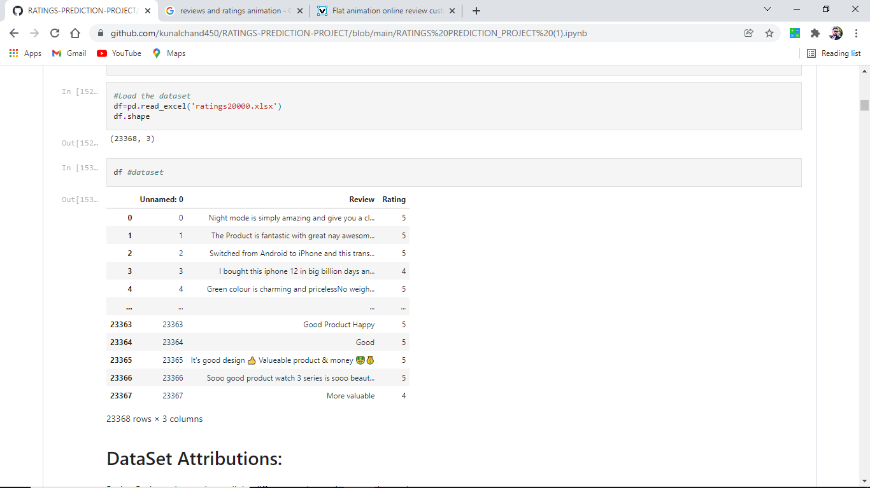
Data set looks as follows

Slide 10
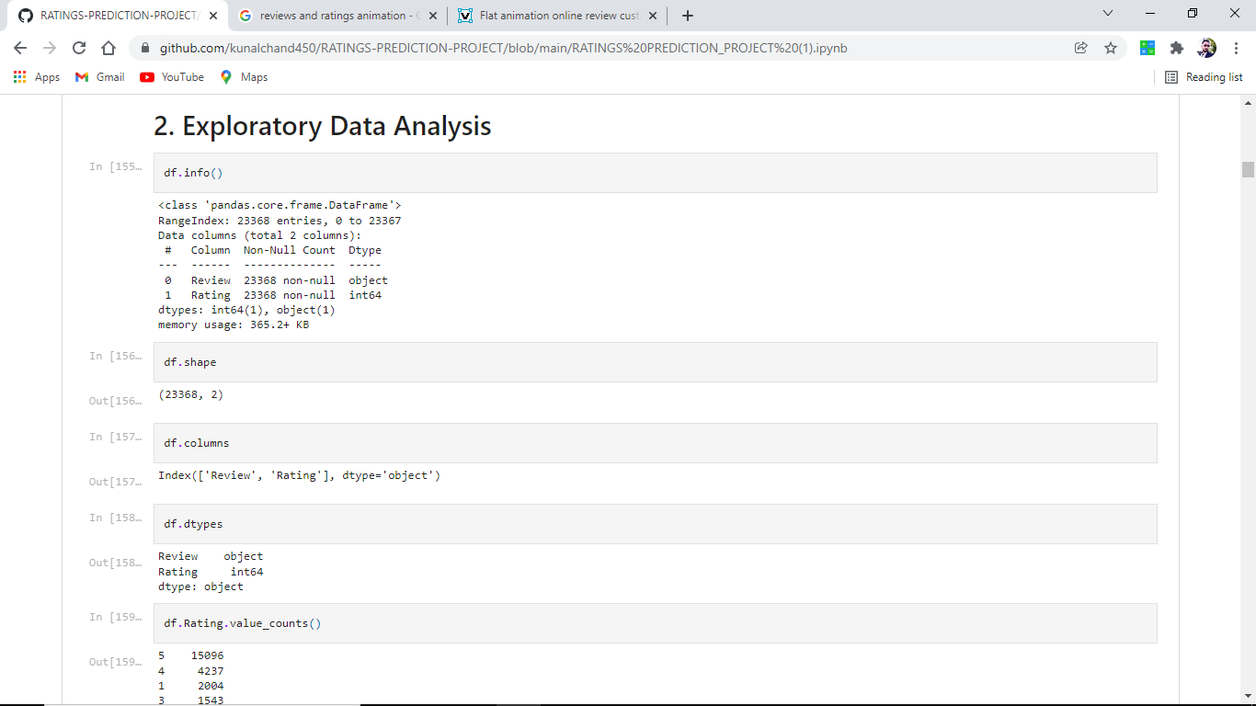
Dataset Information looks as follows

Slide 11
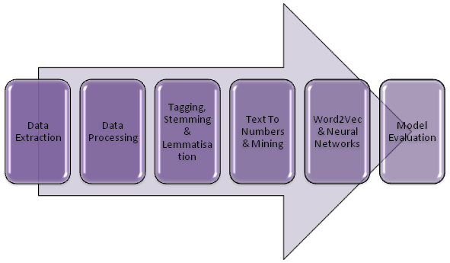
Data Pre-processing Done in following steps.
This project is based on NLP and we have comments or string data for that we have to first convert comments into words then filter and cleaning of data using several libraries and finally convert them into int data type.

Slide 12
Pre-processing steps explanation
1. Data Extraction: It is the first step of any model. most data is in CSV or excel format and for analyzing the data we use data manipulation tool pandas and NumPy after that data is converted into a data frame for analysing the data.
2. Data Cleaning: First we clean the data which have no use in prediction like the index column and Id, then we drop the data which has a high no of missing percentages.
3. Stemming And Lemmatisation: The next step is to tag the words via Text Part Of Speech Tagging. Additionally, we are ready to perform Stemming And Lemmatisation In The NLP Data Science Project.

Slide 13
Pre-processing steps explanation
4.Text Mining Algorithms: The text needs to be converted to numbers. Multiple algorithms compute and use the frequency of the words or group them to help us understand their hidden meanings.
5.Word2Vec Algorithm: Now the numerical data needs to be fed into a model so that we can start forecasting it. We can feed our data to a model. Word2Vec algorithm is gaining popularity. Let’s understand how to Predict Text Using
6. Data transformation is the process of changing the format, structure, or values of data; we use a labelled encoder for coding the object data into integer data.

Slide 14
Pre-processing steps explanation
7. Data Reduction: it is the process of finding the most correlated columns, and combining them because the machine does not understand which feature columns impact the most on accuracy.
8. Data discretization converts a large number of data values into smaller once, so that data evaluation and data management becomes very easy, using box plots is makes a clear understanding of the data.
9.Evaluate NLP Model: Now that the NLP algorithm has started to forecast text, the last step is about assessing the accuracy of the model. Learn How To Evaluate The Model Performance

Slide 15
EDA Concluding Remark
As for any basic model building, we have to understand the type of target variable, the data of the target variable is continued or classified.
Data Analysis is always the difficult part, for better understanding different kinds of bar plots, distribution plots are created with the target Column for finding the insights of the dataset we have.
Analytical Modelling always starts with the target variable we have, and in that case, our target variables are text comments first we have to filter them and make data clean then using different analysis tools select the list of toxic words which makes comments malignant, for that, we create some distribution plots with the target variable to understand which feature columns help to learn the model best and which feature columns reduce the accuracy of the model.
And after finding the relation and correlation with the target variable we choose either Regression Model or Classification Model. Here in this problem, our target feature column is classified so we build our Machine Learning model on classification.

Slide 16
Hardware and Software Requirements and Tools Used
1. Python is widely used in scientific and numeric computing:
2. SciPy is a collection of packages for mathematics, science, and engineering.
3. Pandas are data analysis and modeling libraries.
4. Natural Language Toolkit: NLTK is a leading platform for building Python programs to work with human language data. It provides easy-to-use interfaces to over 50 corpora and lexical resources such as WorldNet, along with a suite of text processing libraries for classification, tokenization, stemming, tagging, parsing, and semantic reasoning, wrappers for industrial-strength NLP libraries.
Libraries Used for this Project include –
1. Pandas
2. NumPy
3. Matplotlib
4. Seaborn
5. Scikit Learn
6. Nltk
7. WordNetLemmatizer
8. TF-IDF vactorrization

Slide 17
Visualizations
Data visualization is the graphical representation of information and data. By using charts, plots, and graphs data visualization tools provide an accessible way to see and understand trends, outliers, and patterns in data.
In the world of Big Data, data visualization tools and technologies are essential to analyze massive amounts of information and make data-driven decisions.

Slide 18
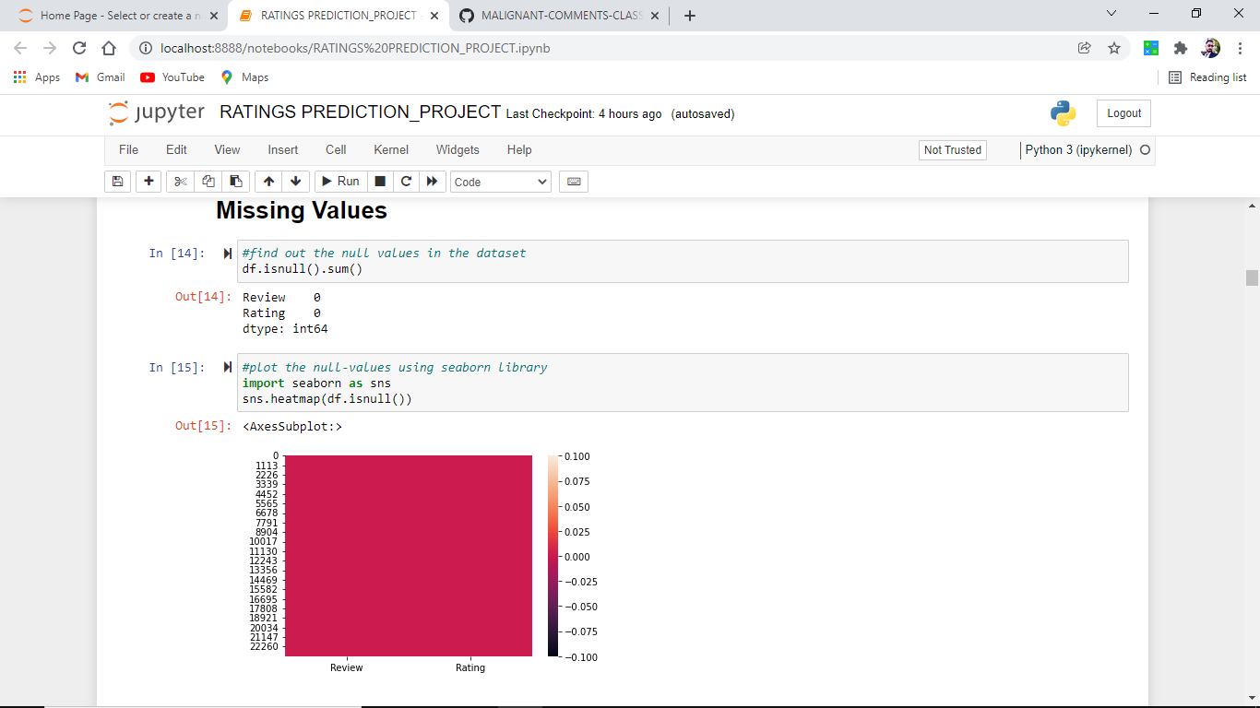
Visualizations

Slide 19
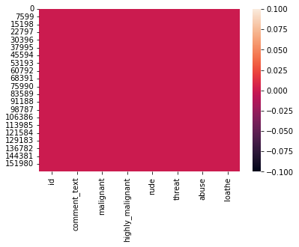
Plotting of heat map using seaborn library
As clearly we analyze that no-null values are present.

Slide 20
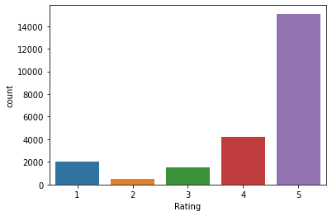
Distribution plot – plotting of different ratings
Classes are not equal.
5* rating having maximum count.

Slide 21
Model/s Development and Evaluation
Identification of possible problem-solving approaches (methods)
After analysing the dataset, I observe that many of the feature columns are int type and Reviews is string type. so first, we have to convert them into an integer so that the machine interprets the data and for that, we use the NLP toolkit for all the features columns.
Then find the correlation between the columns with target columns and delete the non-related feature columns.
After converting text into int datatype and classes are defined.
The target column is classified so we start work on Classification models building.
Testing of Identified Approaches (Algorithms)

Slide 22
List down all the algorithms used for the training and testing.
Logistic Regression
Ridge Classifier
DecisionTreeClassifier
Random forest Regression.
Xgboost
AdaBoostClassifier
KNeighborsClassifier

Slide 23
Run and Evaluate selected models
1. Logistic Regression
2. Decision Tree Classifier
3. Xgboost

Slide 24
Logistic Regression
Logistic Regression is a machine learning algorithm based on supervised learning.
It performs a regression task. Regression models a target prediction value based on independent variables.
It is mostly used for finding out the relationship between variables and forecasting.

Slide 25
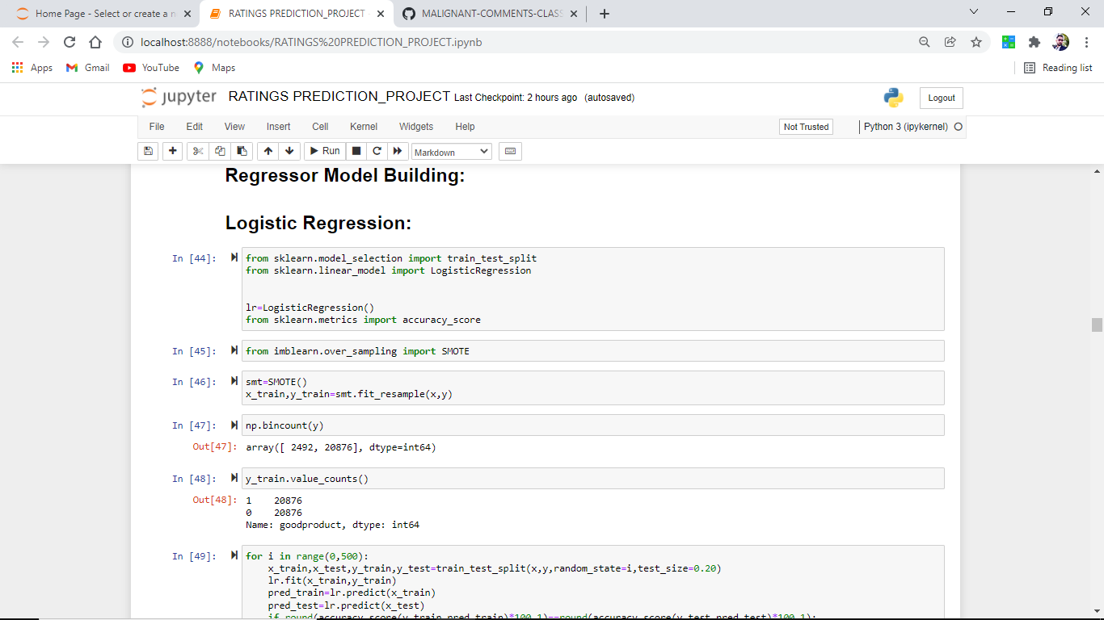
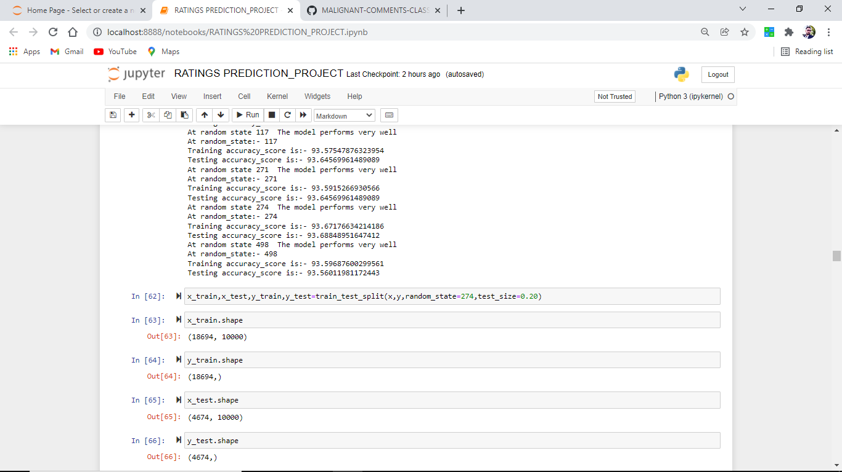
Screenshots of codes

Slide 26
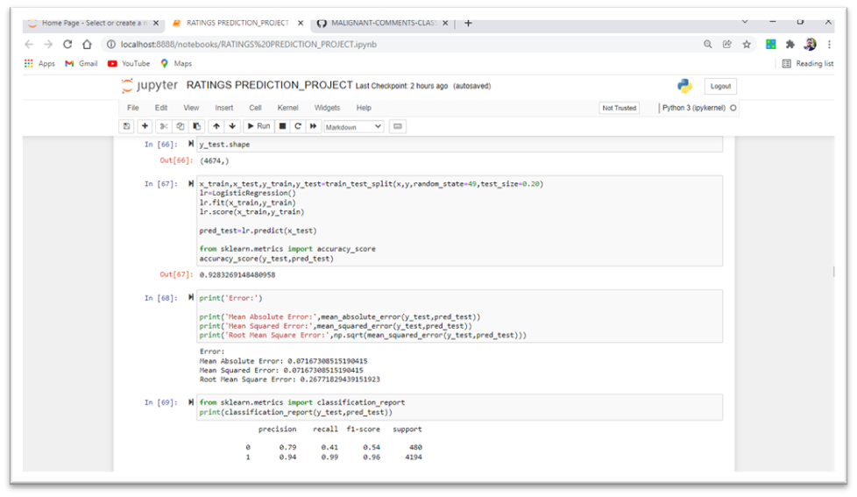
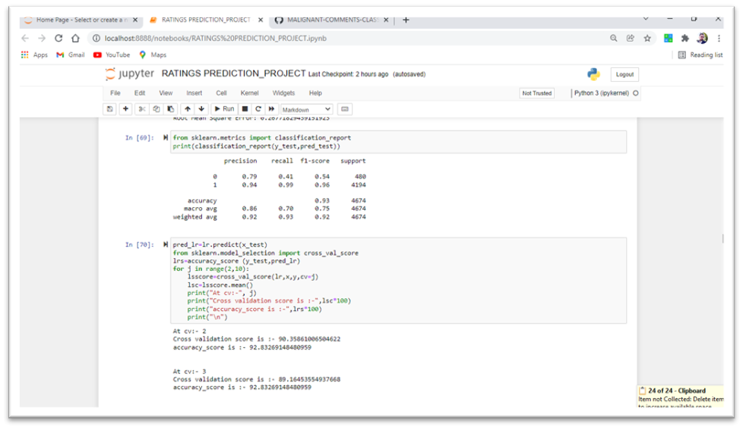
Screenshots of codes

Slide 27
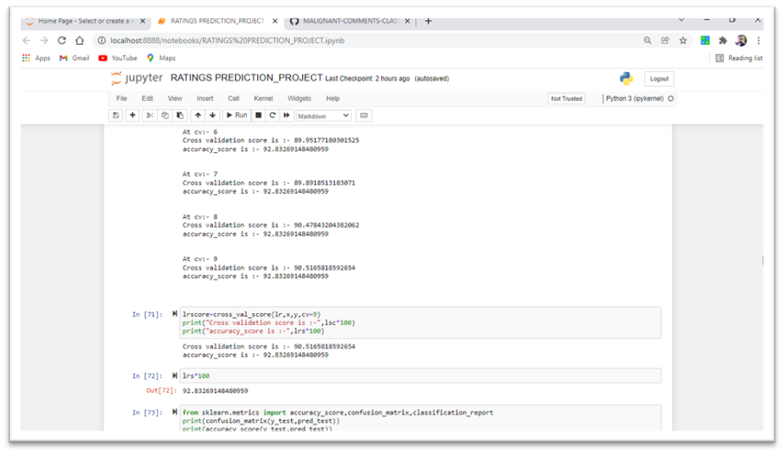
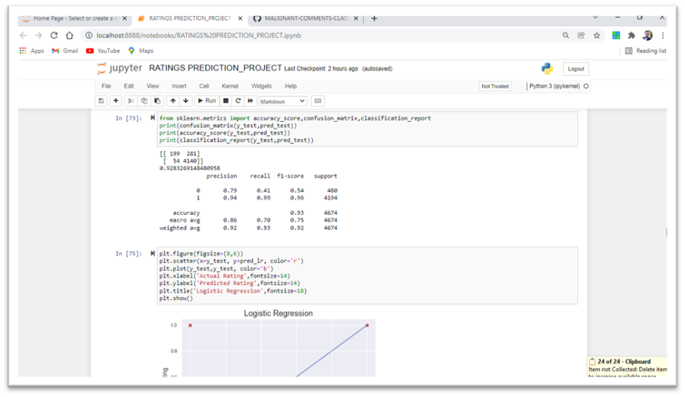
Screenshots of codes

Slide 28
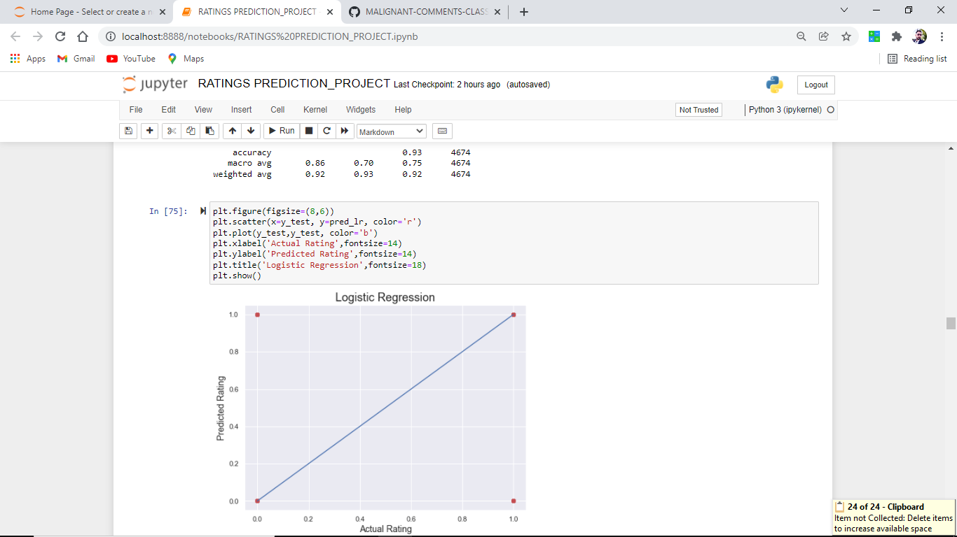
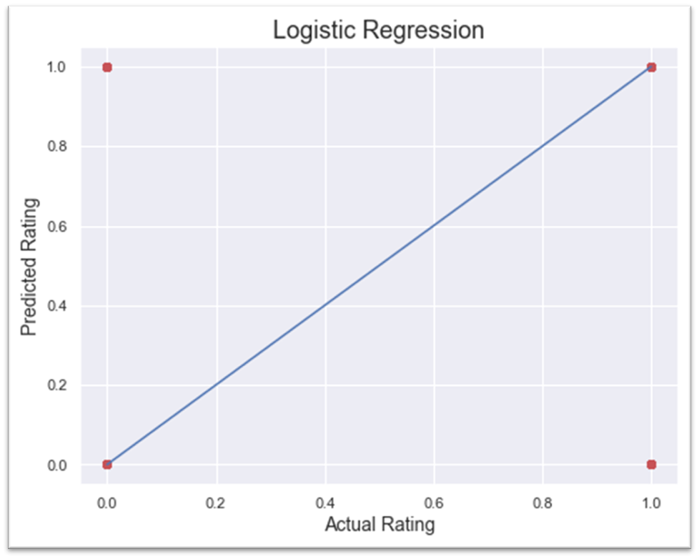
Plotting of predicted data on best fit line

Slide 29
Conclusion of the Logistic Regression
Observations:
1. This Logistic Regression Performs with 92.55% accuracy for predicting labels.
2. We use the best-fit line.
3. from sklearn.metrics import accuracy_score,confusion_matrix,classification_report.

Slide 30
Accuracy_score,confusion_matrix,classification_report.
0.9283269148480958 [[ 199 281] [ 54 4140]]
precision recall f1-score support
0 0.79 0.41 0.54 480
1 0.94 0.99 0.96 4194
accuracy 0.93 4674
macro avg 0.86 0.70 0.75 4674
weighted avg 0.92 0.93 0.92 4674
from above we easily find out that
Precision, recall, Fl-score from the above plotting.
Our model performs well on the initial level,

Slide 31
Error Report
Mean Absolute Error: 0.07167308515190415
Mean Squared Error: 0.07167308515190415
Root Mean Square Error: 0.26771829439151923
We observe very less error data while prediction.

Slide 32
DecisionTreeClassifier
Decisiontreeclassifier is a class capable of performing multi-class classification on a dataset.
As with other classifiers, decisiontreeclassifier takes as input two arrays: an array X, sparse or dense, of shape (n_samples, n_features) holding the training samples, and an array Y of integer values, shape (n_samples,), holding the class labels for the training samples:

Slide 33
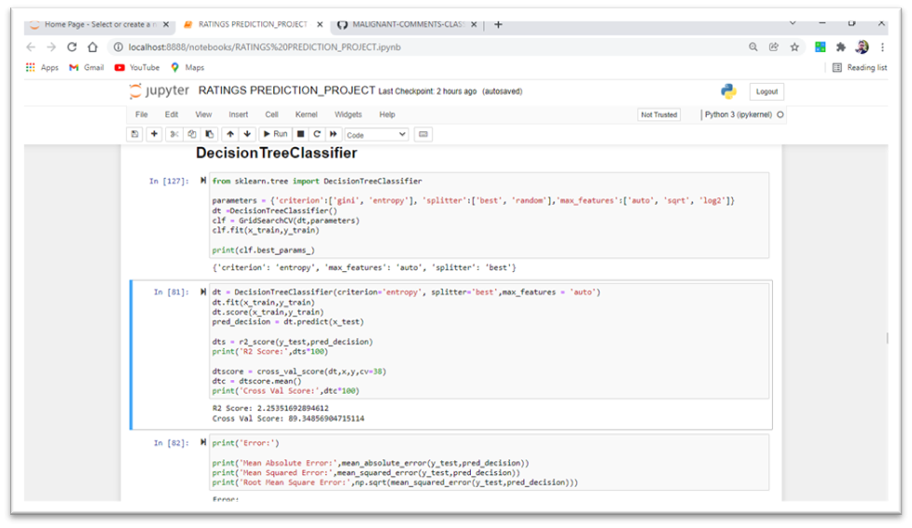
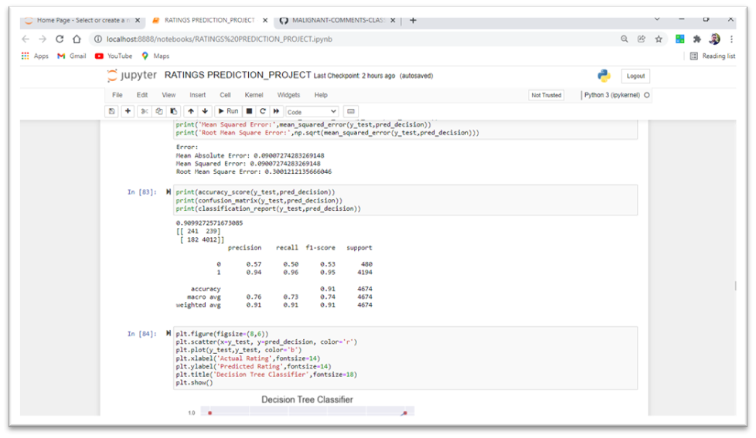
Screenshots of codes

Slide 34
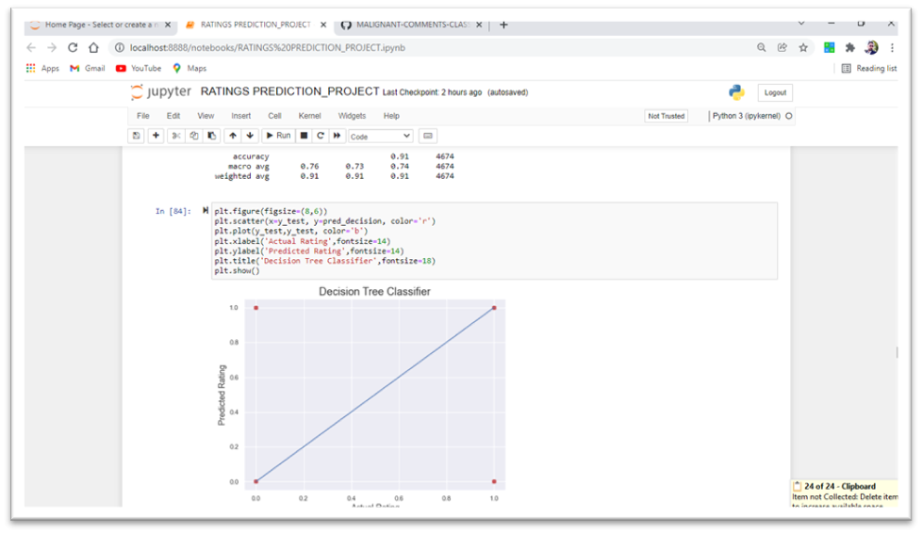
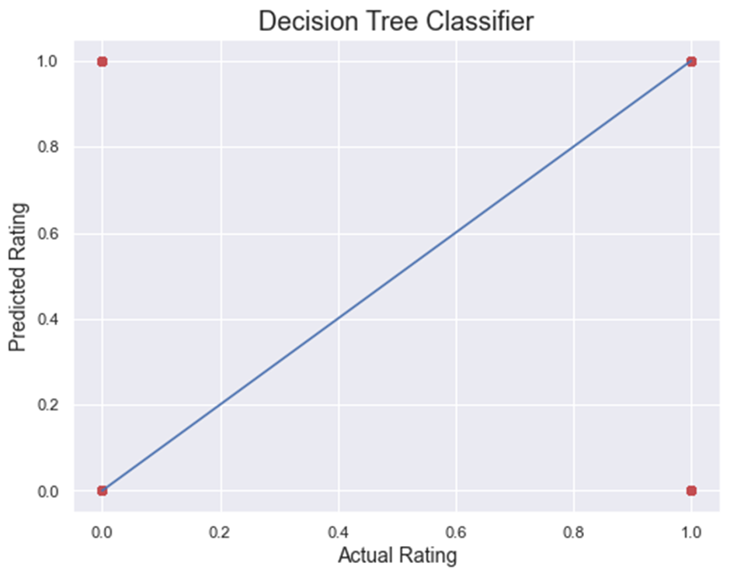
Results on best fit line.

Slide 35
Conclusion of the Decision Tree Classifier.
Observations:
1. This Decision Tree Classifier Performs with 90.23% accuracy for predicting labels.
2. We use the best-fit line.
3. from sklearn.metrics import accuracy_score,confusion_matrix,classification_report.

Slide 36
Error:
Mean Absolute Error: 0.09007274283269148
Mean Squared Error: 0.09007274283269148
Root Mean Square Error: 0.3001212135666046

Slide 37
Accuracy_score,confusion_matrix,classification_report.
0.9099272571673085 [[ 241 239] [ 182 4012]]
precision recall f1-score support
0 0.57 0.50 0.53 480
1 0.94 0.96 0.95 4194
accuracy 0.91 4674
macro avg 0.76 0.73 0.74 4674
weighted avg 0.91 0.91 0.91 4674

Slide 38
XGBOOST
XGBoost provides a wrapper class to allow models to be treated like classifiers or regressor in the sci-kit-learn framework. This means we can use the full sci-kit-learn library with XGBoost models. The XGBoost model for classification is called XGBClassifier.We can create and fit it into our training dataset. Models are fit using the sci-kit-learn API and the model. fit() function. Parameters for training the model can be passed to the model in the constructor.

Slide 39
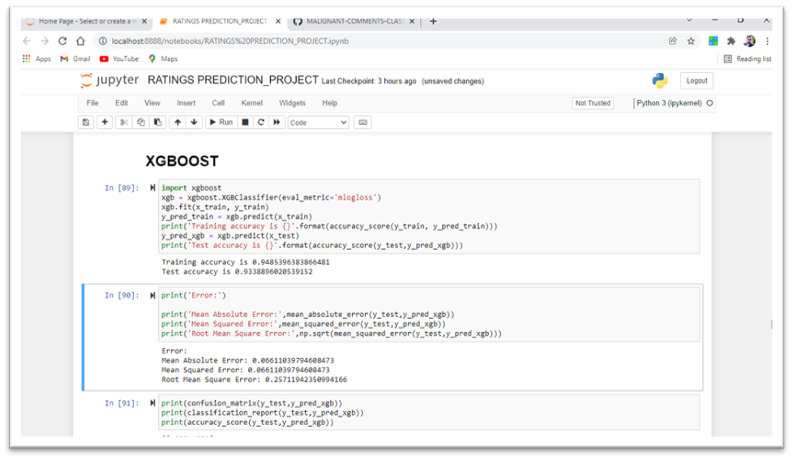
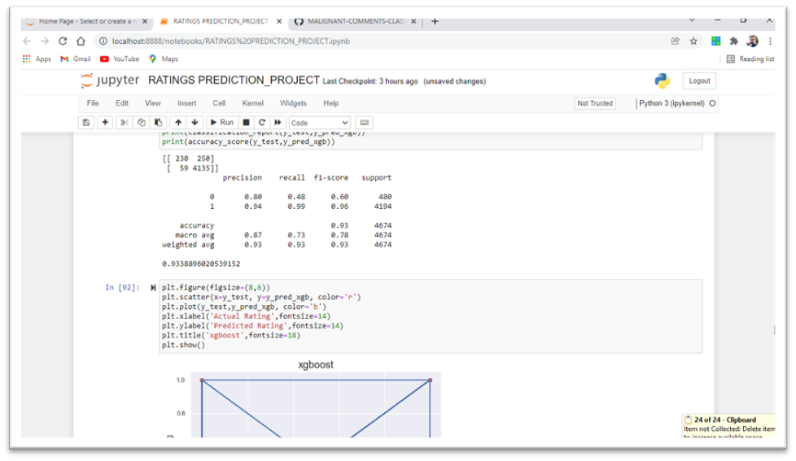
Screenshots of codes

Slide 40
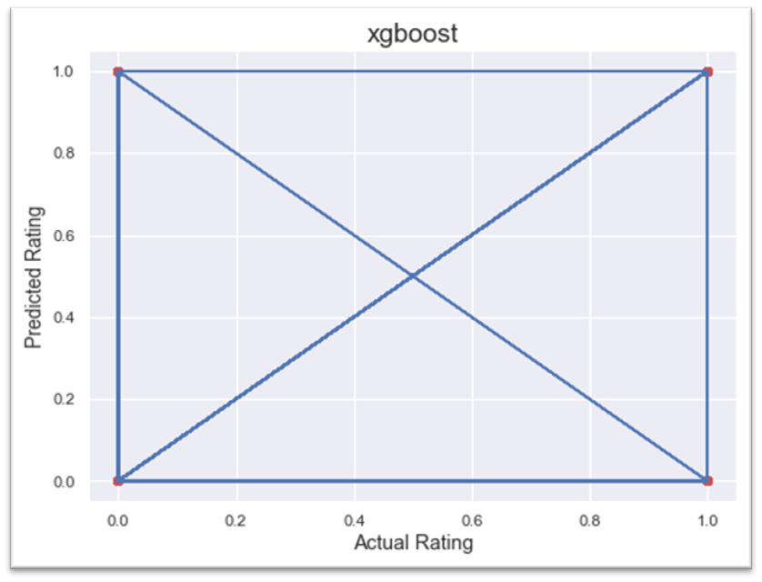
Results on best fit line

Slide 41
Conclusion of the XGBOOST.
Observations:
1. This XGBOOST Performs with 93.38% accuracy for predicting labels.
2. We use the best-fit line.
3. from sklearn.metrics import accuracy_score,confusion_matrix,classification_report.

Slide 42
Error:
Mean Absolute Error: 0.06611039794608473
Mean Squared Error: 0.06611039794608473
Root Mean Square Error: 0.25711942350994166

Slide 43
Accuracy_score,confusion_matrix,classification_report.
0.9338896020539152
[[ 230 250]
[ 59 4135]]
precision recall f1-score support
0 0.80 0.48 0.60 480
1 0.94 0.99 0.96 4194
accuracy 0.93 4674
macro avg 0.87 0.73 0.78 4674
weighted avg 0.93 0.93 0.93 4674

Slide 44
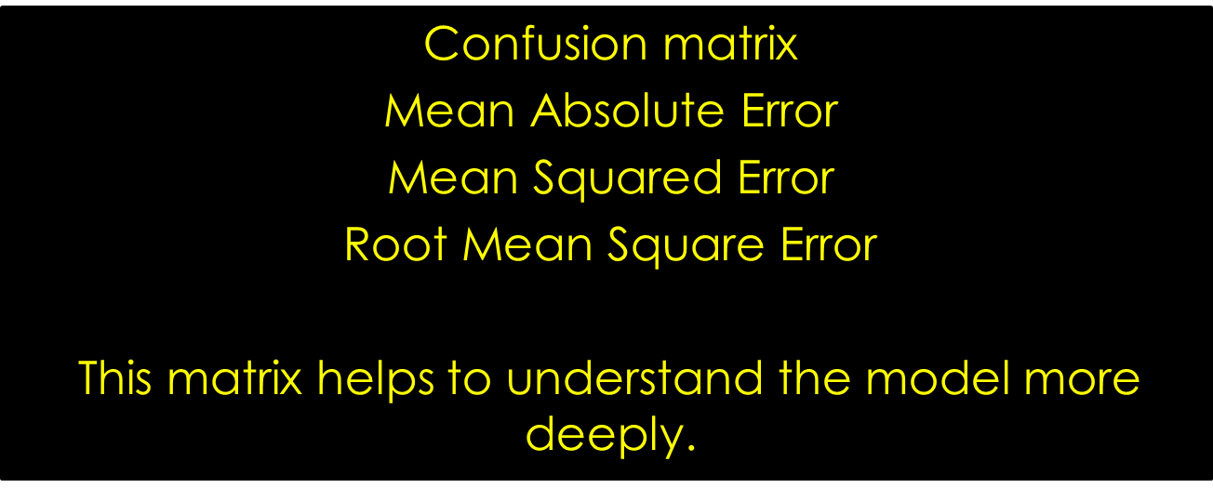
Key Metrics for success in solving the problem under consideration

Slide 45
Interpretation of the Results
List of accuracy scores of different classification models.
logistic Regression:- 0.9283269148480958
Ridge classifier:- 0.9296106118955927
Dicision Tree Classifier:- 0.9099272571673085
Random Forest classifier:- 0.9313222079589217
xgboost:- 0.9338896020539152
AdaBoostClassifier:- 0.9238339751818571
KNeighborsClassifier:- 0.9107830551989731

Slide 46
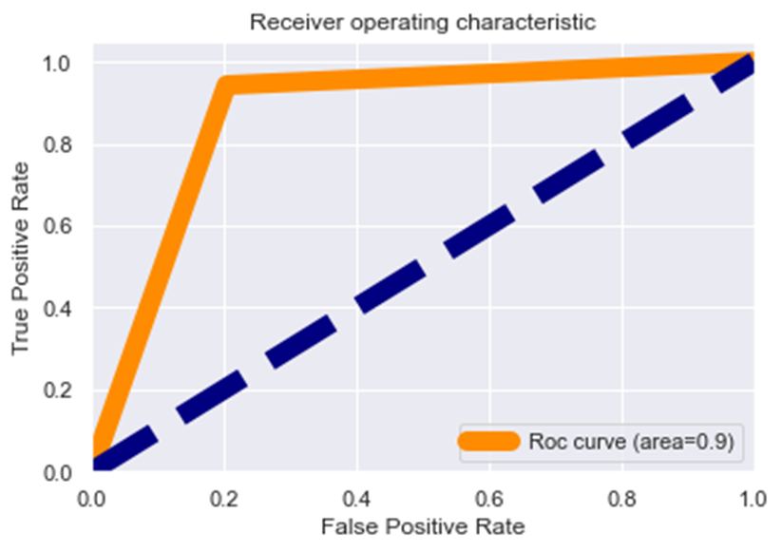
Auc-roc curve

Slide 47
OBSERVATIONS of auc-roc curve
1. Roc curve area is 0.9 which means that our model is distinguished between the good or bad review.
2. Our model understands that Rating 1 is 93.55% different then 0, which is good.
3. It means there is a 93.55% chance that the model will be able to distinguish between positive class and negative class.

Slide 48
Learning Outcomes of the Study in respect of Data Science
That's it! We reached the end of our exercise. Throughout this kernel, we put into practice many of the strategies for predicting whether comments are malignant or not. We philosophized about the variables, we analyzed Review' alone and with the most correlated variables, we tested some of the fundamental statistical assumptions and we even transformed text data into numeric type using tf-idf vectorization. That's a lot of work that Python helped us make easier.

Slide 49
Limitations of this work and Scope for Future Work
As we do lots of research and our data set is quite big which helps us to find different toxic words from around the world which make this study successful still as generations are evolved and continuously discovering new slag words which make comments toxic. we don’t rely on this data for too long continuously adding more stopwords in the nltk library for helping us to make more powerful models and make us future-ready

Slide 50
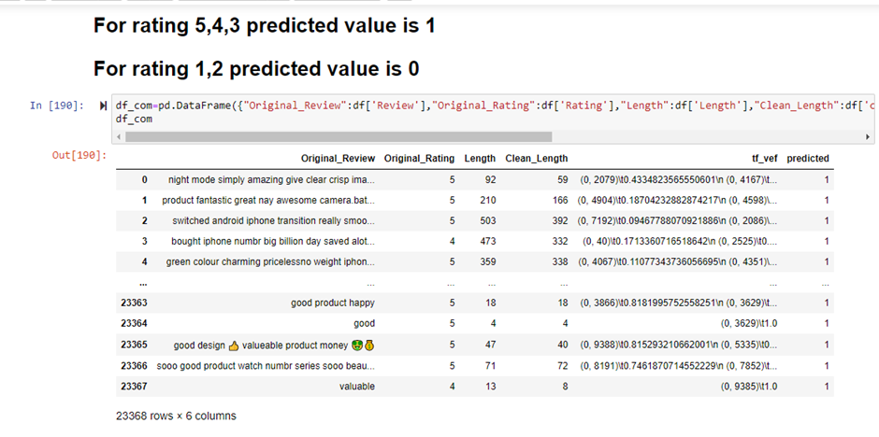
All the work under one roof.
As we observe that good reviews get predicted as 1 which means our model works.

Slide 51
Key Findings and Conclusions of the Study
So, our Aim is achieved as we have successfully tickedall our parameters as mentioned in our Aim Column. It is seen that nltk libraries help us to find the outcomes. All the feature columns are positively co-related.
As our model Accuracy is over 93.38% which is good in terms of initial model building. XGBOOST is the best from rest.

